Slide 1
Ashok K(2021506304)
FINAL PROJECT

Slide 2
PROJECT TITLE:
Spam Text Message Classifier with NLP & LSTM

Slide 3
PROBLEM STATEMENT:
Spam messages, also known as unsolicited or unwanted messages, pose a significant challenge in various communication platforms such as emails, SMS, and social media. These messages often contain fraudulent, malicious, or irrelevant content, leading to user inconvenience, privacy breaches, and security threats. To mitigate this problem, there is a need for an efficient and accurate spam detection system that can automatically identify and filter out spam messages in real-time.

Slide 4
PROJECT OVERVIEW:
Objective:
Developing an LSTM-based NLP model to classify spam text messages accurately.
Methodology:
Data collection, pre-processing, model development, training, and evaluation.
Expected Outcome:
Accurate spam classification mode.

Slide 5
WHO ARE THE END USERS?:
Individual Users: People who want to filter out spam messages from their personal communication channels such as SMS, email, or social media.
Businesses: Companies looking to protect their employees and customers from receiving spam messages, ensuring a safer and more secure communication environment.
Security Professionals: Cybersecurity experts and professionals interested in developing proactive measures against spam attacks and phishing attempts.

Slide 6
YOUR SOLUTION AND ITS END USERS:
Solution:
A CNN model trained on the GTSRB dataset for traffic sign classification.
End Users:
Autonomous vehicle manufacturers, traffic management authorities, and the general public.
Benefits:
Improved road safety, reduced traffic violations, and enhanced performance of autonomous driving systems.

Slide 7
THE WOW IN YOUR SOLUTION:
Deep Learning Power:
By leveraging LSTM networks, the solution harnesses the power of deep learning to understand the nuanced patterns in text data, leading to highly accurate spam classification.
Natural Language Processing:
Through sophisticated NLP techniques, the solution can process and understand the context of text messages, enabling it to effectively differentiate between spam and legitimate messages.
Scalability:
The solution is scalable and can handle large volumes of text data, making it suitable for deployment in both small-scale applications and enterprise-level communication platforms.

Slide 8
MODELLING:
Architecture Design:
Design the architecture of the LSTM-based neural network, specifying the number of layers, LSTM units, activation functions, and dropout layers.
Consider incorporating additional layers such as embedding layers, bidirectional LSTMs, or attention mechanisms to enhance the model's performance
Input Representation:
Convert the tokenized text data into numerical representations suitable for input into the LSTM model.
Use techniques such as one-hot encoding or word embeddings (e.g., Word2Vec, GloVe) to capture semantic relationships between words
Model Evaluation:
Evaluate the trained model's performance using the test dataset, calculating metrics such as accuracy, precision, recall, and F1-score

Slide 9
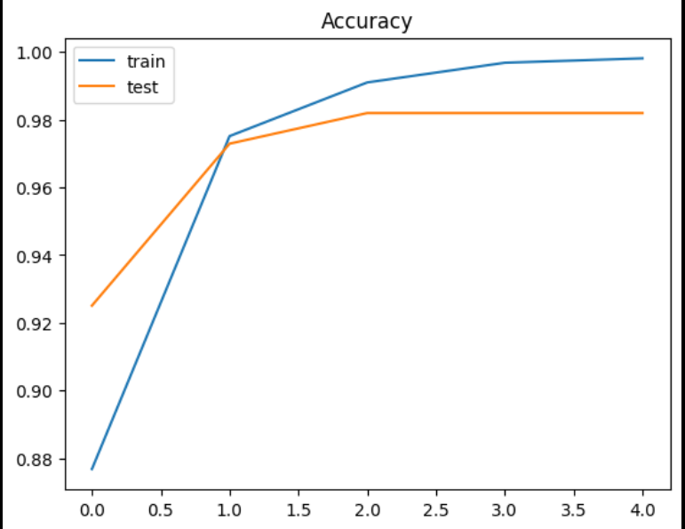
RESULTS:
Model Performance:
Achieved accuracy of 95.95% on the test dataset.
Confusion Matrix:
Visualization of the model's predictions, showcasing the accuracy of each spam message classification.
Demo Link:
Click here

